Slide 1
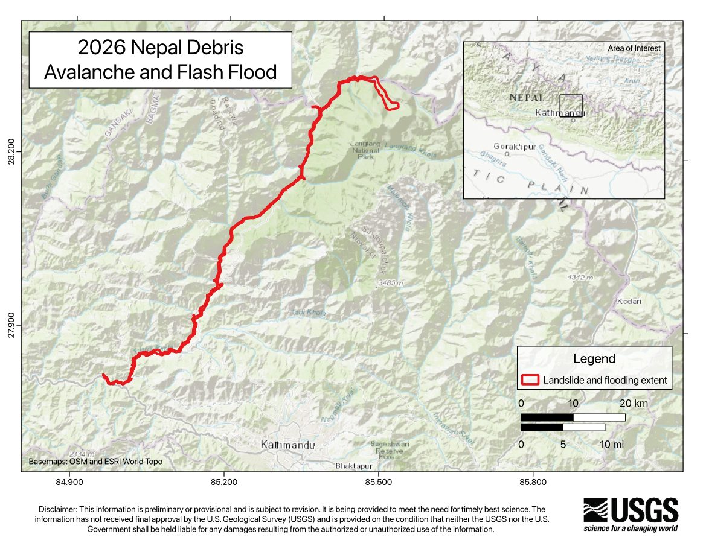
MastermindStack
Rasuwa
When a mountain failure becomes a river-corridor disaster
26 August 2026 • Nepal
Engineering and disaster-risk briefing
Evidence reviewed 10 September 2026
MastermindStack / Rasuwa design example / sources reviewed 10 September 2026
1 / 14
Notes:
Rasuwa
26 August 2026 • Nepal
Engineering and disaster-risk briefing
Evidence reviewed 10 September 2026
USGS. 2026 Nepal Debris Avalanche and Flash Flood. 2026-08-28. https://www.usgs.gov/programs/landslide-hazards/science/2026-nepal-debris-avalanche-and-flash-flood
Scope: Preliminary source failure; unresolved landslide/glacier-collapse distinction; approximately 100 km route; collapse-generated seismic signal.
Limit: Response page frozen after 28 August. Preliminary findings.
Media credits
USGS, 2026. Embedded preliminary disclaimer and OSM/Esri basemap credit retained. / Public domain (USGS)
contains modified Copernicus Sentinel data (2026) and Landsat-9 data, processed by ESA / CC BY 4.0
contains modified Copernicus Sentinel data (2026) and Landsat-9 data, processed by ESA / CC BY 4.0
Evidence reviewed 10 September 2026. No independent human peer review.

Slide 2
The loss extends far downstream
At least 1,300
84,270
deaths reported by AP on 7 September
A dated report, not the final toll
people affected in UNICEF's 4 September assessment
17 municipalities in six districts
Missing-person lists and recovered bodies can overlap. Do not add them.
MastermindStack / Rasuwa design example / sources reviewed 10 September 2026
2 / 14
Notes:
The loss extends far downstream
At least 1,300: deaths reported by AP on 7 September
A dated report, not the final toll
84,270: people affected in UNICEF's 4 September assessment
17 municipalities in six districts
Missing-person lists and recovered bodies can overlap. Do not add them.
Associated Press. Nepal holds a day of mourning after floods kill at least 1,300 people. 2026-09-07. https://apnews.com/article/f5477d09ca1c56541450828302818d73
Scope: Dated report of at least 1,300 deaths and national mourning.
Limit: News-feed result read; direct article fetch failed. Figure not presented as latest or final.
UNICEF Nepal. Humanitarian Situation Report No. 2, Rasuwa Flood. 2026-09-04. https://www.unicef.org/nepal/media/31141/file/UNICEF%20Nepal%20-%20Humanitarian%20Situation%20Report%20No.%202%20(Rasuwa%20Flood).pdf.pdf
Scope: Pages 1–3: 84,270 affected; 32,021 children; 17 municipalities/six districts; 50 water systems and at least 20 schools damaged.
Limit: Dated humanitarian assessment; distinct from legal declaration coverage and casualty registers.
Media credits
USGS, 2026. Embedded preliminary disclaimer and OSM/Esri basemap credit retained. / Public domain (USGS)
contains modified Copernicus Sentinel data (2026) and Landsat-9 data, processed by ESA / CC BY 4.0
contains modified Copernicus Sentinel data (2026) and Landsat-9 data, processed by ESA / CC BY 4.0
Evidence reviewed 10 September 2026. No independent human peer review.

Slide 3
A connected valley corridor
USGS describes approximately 100 km of debris flow and flooding.
USGS preliminary response map
Preliminary response mapping. Not a design inundation surface or current safety boundary.
MastermindStack / Rasuwa design example / sources reviewed 10 September 2026
3 / 14
Notes:
A connected valley corridor
USGS describes approximately 100 km of debris flow and flooding.
Preliminary response mapping. Not a design inundation surface or current safety boundary.
USGS. 2026 Nepal Debris Avalanche and Flash Flood. 2026-08-28. https://www.usgs.gov/programs/landslide-hazards/science/2026-nepal-debris-avalanche-and-flash-flood
Scope: Preliminary source failure; unresolved landslide/glacier-collapse distinction; approximately 100 km route; collapse-generated seismic signal.
Limit: Response page frozen after 28 August. Preliminary findings.
USGS. 2026 Nepal Debris Avalanche and Flash Flood Map. 2026-08-27. https://www.usgs.gov/media/images/2026-nepal-debris-avalanche-and-flash-flood-map
Scope: Preliminary corridor map; public-domain usage declaration.
Limit: Retain embedded disclaimer and basemap credits.
Media credits
USGS, 2026. Embedded preliminary disclaimer and OSM/Esri basemap credit retained. / Public domain (USGS)
contains modified Copernicus Sentinel data (2026) and Landsat-9 data, processed by ESA / CC BY 4.0
contains modified Copernicus Sentinel data (2026) and Landsat-9 data, processed by ESA / CC BY 4.0
Evidence reviewed 10 September 2026. No independent human peer review.

Slide 4
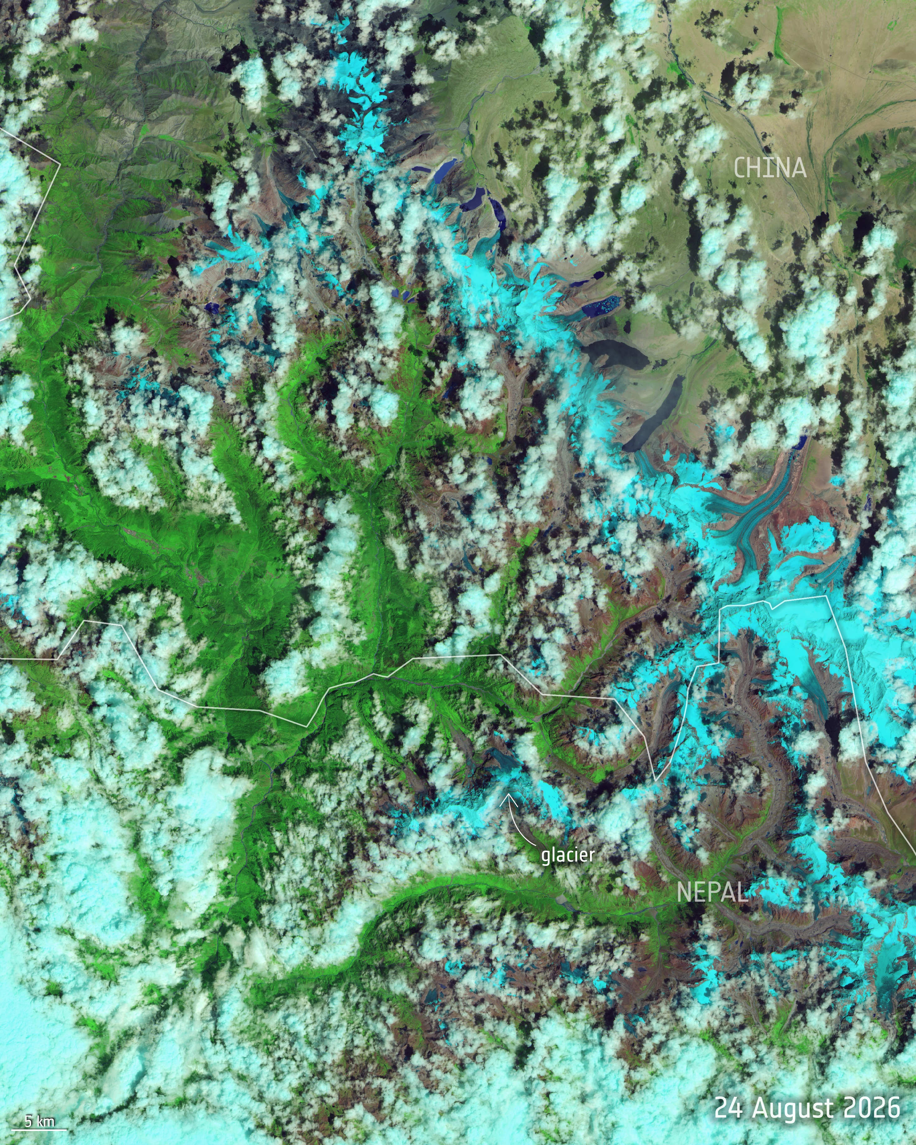
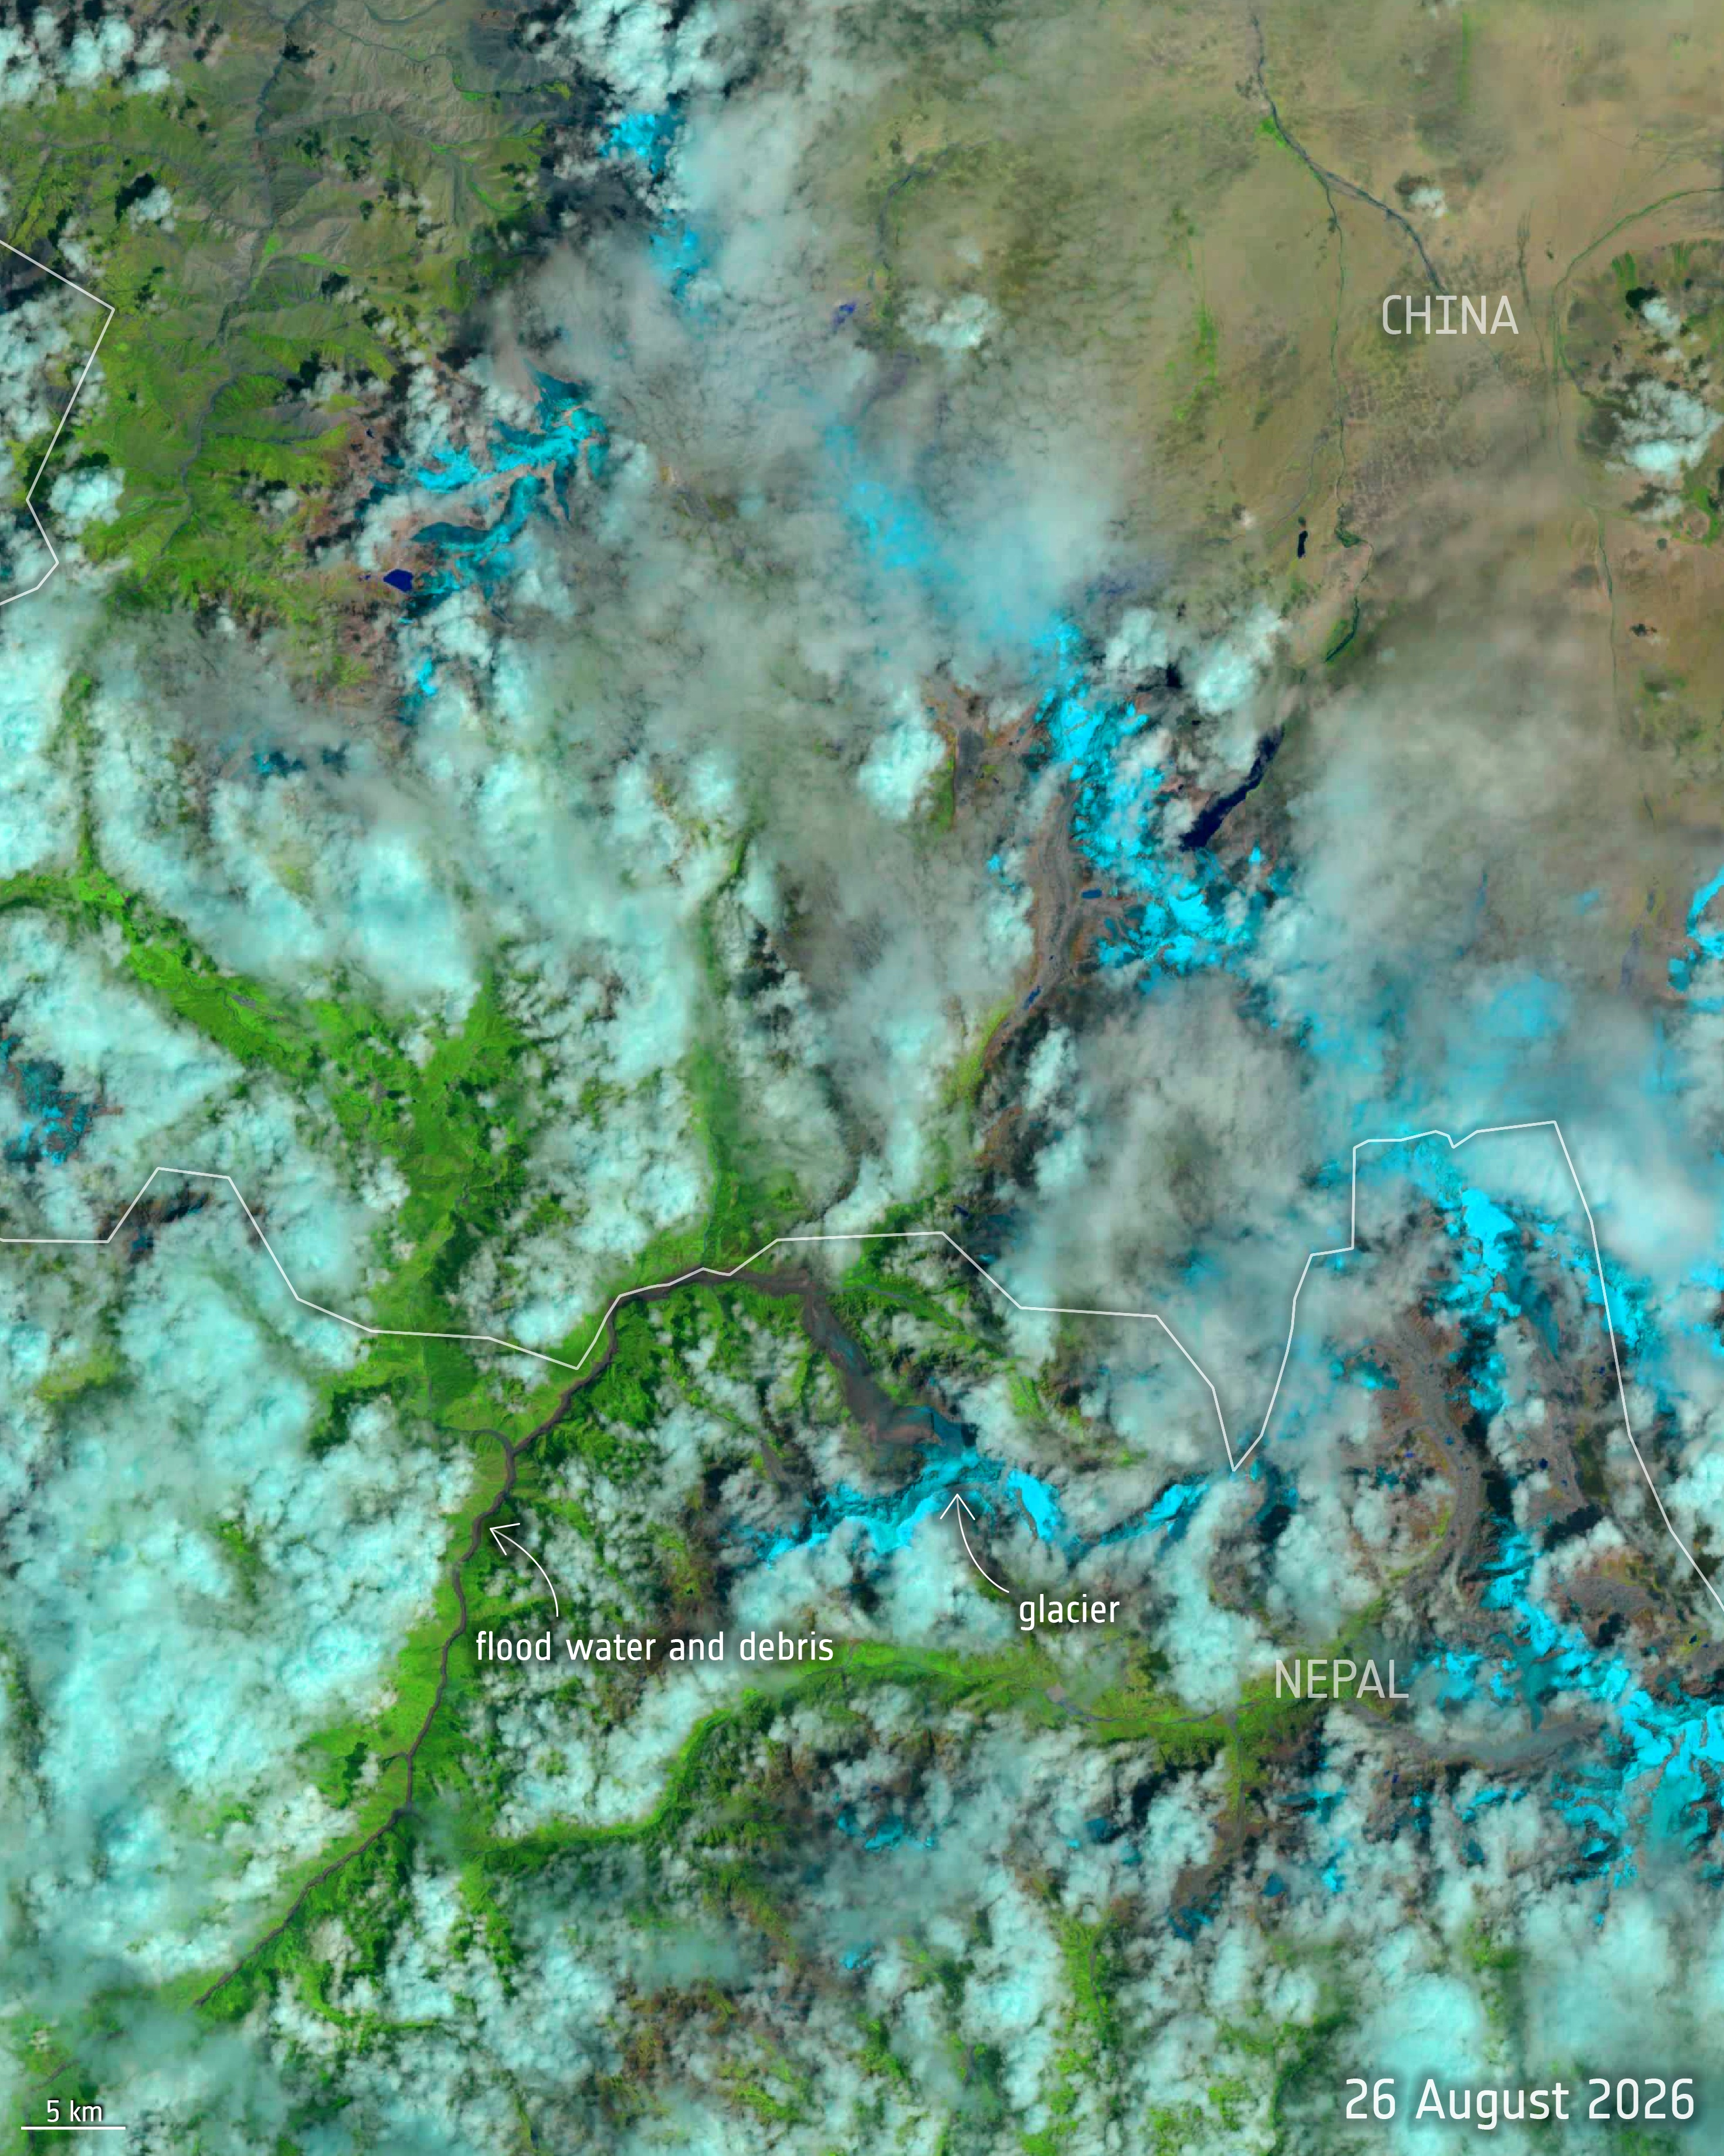
Two observations of the source area
24 August 2026
26 August 2026
Shortwave-infrared composites • Different sensors and cloud conditions • Full source annotations retained
contains modified Copernicus Sentinel data (2026) and Landsat-9 data, processed by ESA
MastermindStack / Rasuwa design example / sources reviewed 10 September 2026
4 / 14
Notes:
Two observations of the source area
24 August: Sentinel-2 • 26 August: Landsat-9
Shortwave-infrared composites • Different sensors and cloud conditions • Full source annotations retained
ESA. Nepal glacier collapse and flood – before and after. 2026-08-31. https://www.esa.int/ESA_Multimedia/Images/2026/08/Nepal_glacier_collapse_and_flood_before_and_after
Scope: 24 August Sentinel-2 / 26 August Landsat-9 image dates, shortwave-infrared processing and CC BY 4.0 licence.
Limit: Different sensors; cloud obscuration; images do not establish failure volumes.
Media credits
USGS, 2026. Embedded preliminary disclaimer and OSM/Esri basemap credit retained. / Public domain (USGS)
contains modified Copernicus Sentinel data (2026) and Landsat-9 data, processed by ESA / CC BY 4.0
contains modified Copernicus Sentinel data (2026) and Landsat-9 data, processed by ESA / CC BY 4.0
Evidence reviewed 10 September 2026. No independent human peer review.

Slide 5
The trigger remains provisional
USGS, 28 August
Seismic interpretation
Causal limits
Rapid slope failure involving a glacier.
Unresolved: landslide incorporating ice or glacier collapse.
The slope failure generated an M5.2-equivalent signal.
This is not proof of a tectonic earthquake trigger.
Glacier involvement alone does not establish a lake outburst.
Event-specific climate attribution remains unresolved.
MastermindStack / Rasuwa design example / sources reviewed 10 September 2026
5 / 14
Notes:
The trigger remains provisional
USGS, 28 August: Rapid slope failure involving a glacier.
Unresolved: landslide incorporating ice or glacier collapse.
Seismic interpretation: The slope failure generated an M5.2-equivalent signal.
This is not proof of a tectonic earthquake trigger.
Causal limits: Glacier involvement alone does not establish a lake outburst.
Event-specific climate attribution remains unresolved.
USGS. 2026 Nepal Debris Avalanche and Flash Flood. 2026-08-28. https://www.usgs.gov/programs/landslide-hazards/science/2026-nepal-debris-avalanche-and-flash-flood
Scope: Preliminary source failure; unresolved landslide/glacier-collapse distinction; approximately 100 km route; collapse-generated seismic signal.
Limit: Response page frozen after 28 August. Preliminary findings.
ICIMOD. Major flash flood sweeps through Nepal's Rasuwa district. 2026-08-27. https://www.icimod.org/press-release/major-flash-flood-sweeps-through-nepals-rasuwa-district-raising-fears-of-further-downstream-flooding/
Scope: Avalanche and temporary blockage hypotheses; reported stage rises; monitoring damage; event-attribution limits.
Limit: Early advisory. Later USGS interpretation governs seismic wording. Reported rises are not design loads.
Media credits
USGS, 2026. Embedded preliminary disclaimer and OSM/Esri basemap credit retained. / Public domain (USGS)
contains modified Copernicus Sentinel data (2026) and Landsat-9 data, processed by ESA / CC BY 4.0
contains modified Copernicus Sentinel data (2026) and Landsat-9 data, processed by ESA / CC BY 4.0
Evidence reviewed 10 September 2026. No independent human peer review.

Slide 6
Evidence matures on different clocks
26 AUG
Disaster and post-event Landsat observation
28 AUG
USGS publishes provisional findings
04 SEP
UNICEF dates its population and service assessment
09 SEP
WHO reports strengthened health surveillance
Publication dates and observation dates are different. This is not a flood-arrival timeline.
MastermindStack / Rasuwa design example / sources reviewed 10 September 2026
6 / 14
Notes:
Evidence matures on different clocks
26 AUG: Disaster and post-event Landsat observation
28 AUG: USGS publishes provisional findings
04 SEP: UNICEF dates its population and service assessment
09 SEP: WHO reports strengthened health surveillance
Publication dates and observation dates are different. This is not a flood-arrival timeline.
USGS. 2026 Nepal Debris Avalanche and Flash Flood. 2026-08-28. https://www.usgs.gov/programs/landslide-hazards/science/2026-nepal-debris-avalanche-and-flash-flood
Scope: Preliminary source failure; unresolved landslide/glacier-collapse distinction; approximately 100 km route; collapse-generated seismic signal.
Limit: Response page frozen after 28 August. Preliminary findings.
ESA. Nepal glacier collapse and flood – before and after. 2026-08-31. https://www.esa.int/ESA_Multimedia/Images/2026/08/Nepal_glacier_collapse_and_flood_before_and_after
Scope: 24 August Sentinel-2 / 26 August Landsat-9 image dates, shortwave-infrared processing and CC BY 4.0 licence.
Limit: Different sensors; cloud obscuration; images do not establish failure volumes.
UNICEF Nepal. Humanitarian Situation Report No. 2, Rasuwa Flood. 2026-09-04. https://www.unicef.org/nepal/media/31141/file/UNICEF%20Nepal%20-%20Humanitarian%20Situation%20Report%20No.%202%20(Rasuwa%20Flood).pdf.pdf
Scope: Pages 1–3: 84,270 affected; 32,021 children; 17 municipalities/six districts; 50 water systems and at least 20 schools damaged.
Limit: Dated humanitarian assessment; distinct from legal declaration coverage and casualty registers.
WHO Nepal. Strengthening post-disaster surveillance after Nepal's flash floods. 2026-09-09. https://www.who.int/nepal/news/detail/09-09-2026-strengthening-post-disaster-surveillance-after-nepal-s-flash-floods
Scope: Surveillance strengthened; 4 September fever/rash signal investigated without confirmation of a common febrile-rash outbreak.
Limit: No claim that all health risks have ended.
Media credits
USGS, 2026. Embedded preliminary disclaimer and OSM/Esri basemap credit retained. / Public domain (USGS)
contains modified Copernicus Sentinel data (2026) and Landsat-9 data, processed by ESA / CC BY 4.0
contains modified Copernicus Sentinel data (2026) and Landsat-9 data, processed by ESA / CC BY 4.0
Evidence reviewed 10 September 2026. No independent human peer review.

Slide 7
A stage rise is not a design load
River-level rises reported by ICIMOD, 26 August advisory
Metres of reported stage rise over roughly 30 minutes. Not settlement flood depth, discharge or structural load.
MastermindStack / Rasuwa design example / sources reviewed 10 September 2026
7 / 14
Notes:
A stage rise is not a design load
River-level rises reported by ICIMOD, 26 August advisory
Metres of reported stage rise over roughly 30 minutes. Not settlement flood depth, discharge or structural load.
ICIMOD. Major flash flood sweeps through Nepal's Rasuwa district. 2026-08-27. https://www.icimod.org/press-release/major-flash-flood-sweeps-through-nepals-rasuwa-district-raising-fears-of-further-downstream-flooding/
Scope: Avalanche and temporary blockage hypotheses; reported stage rises; monitoring damage; event-attribution limits.
Limit: Early advisory. Later USGS interpretation governs seismic wording. Reported rises are not design loads.
Media credits
USGS, 2026. Embedded preliminary disclaimer and OSM/Esri basemap credit retained. / Public domain (USGS)
contains modified Copernicus Sentinel data (2026) and Landsat-9 data, processed by ESA / CC BY 4.0
contains modified Copernicus Sentinel data (2026) and Landsat-9 data, processed by ESA / CC BY 4.0
Evidence reviewed 10 September 2026. No independent human peer review.

Slide 8
The corridor is the engineering unit
Source and route
Shared dependencies
Required functions
Constrain failure geometry, water sources, entrainment and possible blockages.
Trace common access roads, power and communications across sites.
Separate damaged structures, deliberate shutdowns and loss of service.
Engineering synthesis: investigation priorities, not established site-specific failure findings.
MastermindStack / Rasuwa design example / sources reviewed 10 September 2026
8 / 14
Notes:
The corridor is the engineering unit
Source and route: Constrain failure geometry, water sources, entrainment and possible blockages.
Shared dependencies: Trace common access roads, power and communications across sites.
Required functions: Separate damaged structures, deliberate shutdowns and loss of service.
Engineering synthesis: investigation priorities, not established site-specific failure findings.
USGS. 2026 Nepal Debris Avalanche and Flash Flood. 2026-08-28. https://www.usgs.gov/programs/landslide-hazards/science/2026-nepal-debris-avalanche-and-flash-flood
Scope: Preliminary source failure; unresolved landslide/glacier-collapse distinction; approximately 100 km route; collapse-generated seismic signal.
Limit: Response page frozen after 28 August. Preliminary findings.
WHO Nepal. Strengthening post-disaster surveillance after Nepal's flash floods. 2026-09-09. https://www.who.int/nepal/news/detail/09-09-2026-strengthening-post-disaster-surveillance-after-nepal-s-flash-floods
Scope: Surveillance strengthened; 4 September fever/rash signal investigated without confirmation of a common febrile-rash outbreak.
Limit: No claim that all health risks have ended.
Media credits
USGS, 2026. Embedded preliminary disclaimer and OSM/Esri basemap credit retained. / Public domain (USGS)
contains modified Copernicus Sentinel data (2026) and Landsat-9 data, processed by ESA / CC BY 4.0
contains modified Copernicus Sentinel data (2026) and Landsat-9 data, processed by ESA / CC BY 4.0
Evidence reviewed 10 September 2026. No independent human peer review.

Slide 9
Warning needs an auditable chain
Detection • Interpretation • Authorisation
Transmission • Receipt • Protective action
Record the time and owner of each step.
Test loss of a station, power or communications.
Verify that people can act on the message.
Proposed review method. No claim that a particular warning would have prevented this disaster.
MastermindStack / Rasuwa design example / sources reviewed 10 September 2026
9 / 14
Notes:
Warning needs an auditable chain
Detection • Interpretation • Authorisation
Transmission • Receipt • Protective action
Record the time and owner of each step.
Test loss of a station, power or communications.
Verify that people can act on the message.
Proposed review method. No claim that a particular warning would have prevented this disaster.
ICIMOD. Major flash flood sweeps through Nepal's Rasuwa district. 2026-08-27. https://www.icimod.org/press-release/major-flash-flood-sweeps-through-nepals-rasuwa-district-raising-fears-of-further-downstream-flooding/
Scope: Avalanche and temporary blockage hypotheses; reported stage rises; monitoring damage; event-attribution limits.
Limit: Early advisory. Later USGS interpretation governs seismic wording. Reported rises are not design loads.
Media credits
USGS, 2026. Embedded preliminary disclaimer and OSM/Esri basemap credit retained. / Public domain (USGS)
contains modified Copernicus Sentinel data (2026) and Landsat-9 data, processed by ESA / CC BY 4.0
contains modified Copernicus Sentinel data (2026) and Landsat-9 data, processed by ESA / CC BY 4.0
Evidence reviewed 10 September 2026. No independent human peer review.

Slide 10
Recovery depends on essential services
50
At least 20
water systems damaged
schools damaged
UNICEF assessment, 4 September 2026. Damage counts do not measure the number of people served.
MastermindStack / Rasuwa design example / sources reviewed 10 September 2026
10 / 14
Notes:
Recovery depends on essential services
50: water systems damaged
At least 20: schools damaged
UNICEF assessment, 4 September 2026. Damage counts do not measure the number of people served.
UNICEF Nepal. Humanitarian Situation Report No. 2, Rasuwa Flood. 2026-09-04. https://www.unicef.org/nepal/media/31141/file/UNICEF%20Nepal%20-%20Humanitarian%20Situation%20Report%20No.%202%20(Rasuwa%20Flood).pdf.pdf
Scope: Pages 1–3: 84,270 affected; 32,021 children; 17 municipalities/six districts; 50 water systems and at least 20 schools damaged.
Limit: Dated humanitarian assessment; distinct from legal declaration coverage and casualty registers.
Media credits
USGS, 2026. Embedded preliminary disclaimer and OSM/Esri basemap credit retained. / Public domain (USGS)
contains modified Copernicus Sentinel data (2026) and Landsat-9 data, processed by ESA / CC BY 4.0
contains modified Copernicus Sentinel data (2026) and Landsat-9 data, processed by ESA / CC BY 4.0
Evidence reviewed 10 September 2026. No independent human peer review.

Slide 11
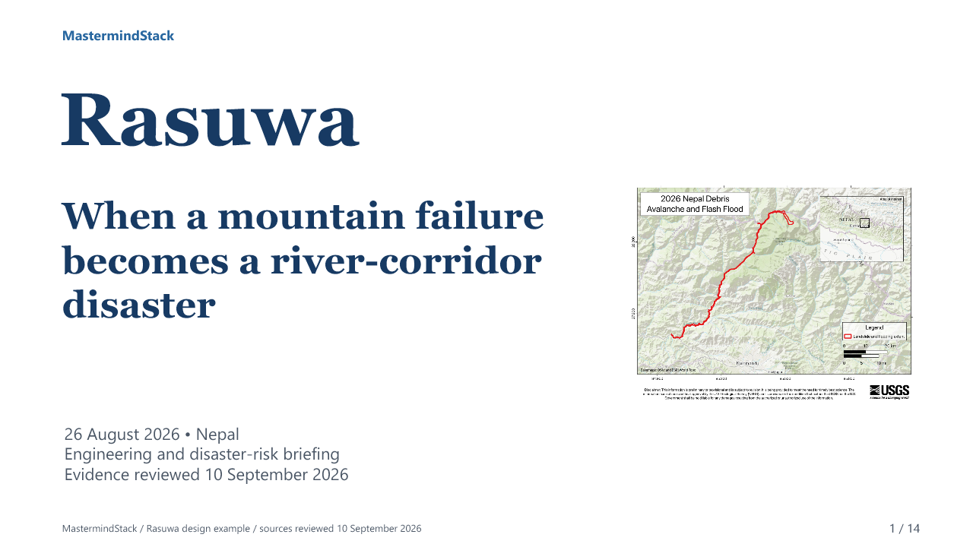
The source imagery, explained
One-minute original editorial sequence
Satellite observations, map and evidence limits
Select the image to play the video.
Embedded MP4 • Captioned • Silent by design • Still-image sequence, not footage of the disaster
MastermindStack / Rasuwa design example / sources reviewed 10 September 2026
11 / 14
Notes:
The source imagery, explained
One-minute original editorial sequence
Satellite observations, map and evidence limits
Embedded MP4 • Captioned • Silent by design • Still-image sequence, not footage of the disaster
USGS. 2026 Nepal Debris Avalanche and Flash Flood. 2026-08-28. https://www.usgs.gov/programs/landslide-hazards/science/2026-nepal-debris-avalanche-and-flash-flood
Scope: Preliminary source failure; unresolved landslide/glacier-collapse distinction; approximately 100 km route; collapse-generated seismic signal.
Limit: Response page frozen after 28 August. Preliminary findings.
ESA. Nepal glacier collapse and flood – before and after. 2026-08-31. https://www.esa.int/ESA_Multimedia/Images/2026/08/Nepal_glacier_collapse_and_flood_before_and_after
Scope: 24 August Sentinel-2 / 26 August Landsat-9 image dates, shortwave-infrared processing and CC BY 4.0 licence.
Limit: Different sensors; cloud obscuration; images do not establish failure volumes.
USGS. 2026 Nepal Debris Avalanche and Flash Flood Map. 2026-08-27. https://www.usgs.gov/media/images/2026-nepal-debris-avalanche-and-flash-flood-map
Scope: Preliminary corridor map; public-domain usage declaration.
Limit: Retain embedded disclaimer and basemap credits.
Media credits
USGS, 2026. Embedded preliminary disclaimer and OSM/Esri basemap credit retained. / Public domain (USGS)
contains modified Copernicus Sentinel data (2026) and Landsat-9 data, processed by ESA / CC BY 4.0
contains modified Copernicus Sentinel data (2026) and Landsat-9 data, processed by ESA / CC BY 4.0
Evidence reviewed 10 September 2026. No independent human peer review.

Slide 12
Expert perspectives in their original players
Deccan Herald
Interview with ICIMOD's Saswata Sanyal
Open the official YouTube player
Al Jazeera • Inside Story
Programme published 28 August 2026
Open the official 27:52 programme
Internet required. Early interviews are context; the dated primary assessments govern this briefing.
MastermindStack / Rasuwa design example / sources reviewed 10 September 2026
12 / 14
Notes:
Expert perspectives in their original players
Deccan Herald: Interview with ICIMOD's Saswata Sanyal
Open the official YouTube player: https://www.youtube.com/watch?v=t31y9dV8Pys
Al Jazeera • Inside Story: Programme published 28 August 2026
Open the official 27:52 programme: https://www.aljazeera.com/video/inside-story/2026/8/28/what-lessons-can-be-learned-from-the-nepal-tibet-flood
Internet required. Early interviews are context; the dated primary assessments govern this briefing.
ICIMOD. Kyirong–Rasuwa flood 2026, Nepal–China border. 2026-09-10. https://www.icimod.org/kyirong-rasuwa-flood-2026-nepal-china-border/
Scope: Association of linked expert interviews with the event.
Limit: Early video descriptions contain evolving mechanisms. No download licence established.
Media credits
USGS, 2026. Embedded preliminary disclaimer and OSM/Esri basemap credit retained. / Public domain (USGS)
contains modified Copernicus Sentinel data (2026) and Landsat-9 data, processed by ESA / CC BY 4.0
contains modified Copernicus Sentinel data (2026) and Landsat-9 data, processed by ESA / CC BY 4.0
Evidence reviewed 10 September 2026. No independent human peer review.

Slide 13
Three decisions for a technical review
Preserve competing source hypotheses.
Test infrastructure dependencies together.
Demonstrate the full warning chain.
Recovery priorities should name the service restored,
the people reached and the residual hazard.
Engineering synthesis • No event-specific design values or recurrence estimates are proposed.
MastermindStack / Rasuwa design example / sources reviewed 10 September 2026
13 / 14
Notes:
Three decisions for a technical review
Preserve competing source hypotheses.
Test infrastructure dependencies together.
Demonstrate the full warning chain.
Recovery priorities should name the service restored,
the people reached and the residual hazard.
Engineering synthesis • No event-specific design values or recurrence estimates are proposed.
USGS. 2026 Nepal Debris Avalanche and Flash Flood. 2026-08-28. https://www.usgs.gov/programs/landslide-hazards/science/2026-nepal-debris-avalanche-and-flash-flood
Scope: Preliminary source failure; unresolved landslide/glacier-collapse distinction; approximately 100 km route; collapse-generated seismic signal.
Limit: Response page frozen after 28 August. Preliminary findings.
WHO Nepal. Strengthening post-disaster surveillance after Nepal's flash floods. 2026-09-09. https://www.who.int/nepal/news/detail/09-09-2026-strengthening-post-disaster-surveillance-after-nepal-s-flash-floods
Scope: Surveillance strengthened; 4 September fever/rash signal investigated without confirmation of a common febrile-rash outbreak.
Limit: No claim that all health risks have ended.
Media credits
USGS, 2026. Embedded preliminary disclaimer and OSM/Esri basemap credit retained. / Public domain (USGS)
contains modified Copernicus Sentinel data (2026) and Landsat-9 data, processed by ESA / CC BY 4.0
contains modified Copernicus Sentinel data (2026) and Landsat-9 data, processed by ESA / CC BY 4.0
Evidence reviewed 10 September 2026. No independent human peer review.

Slide 14
Sources and publication record
USGS • Event findings, 28 August; response map, 27 August
ICIMOD • Advisory, 26–27 August
ESA • Satellite comparison, published 31 August
Associated Press • Mourning report, 7 September
UNICEF • Situation Report 2, 4 September
WHO • Surveillance report, 9 September
Full URLs and media credits are in the speaker notes and public edition.
MastermindStack editorial research • v1.0.0 • 10 September 2026
Desk-based analysis; no field investigation or independent peer review.
MastermindStack / Rasuwa design example / sources reviewed 10 September 2026
14 / 14
Notes:
Sources and publication record
USGS • Event findings, 28 August; response map, 27 August
ICIMOD • Advisory, 26–27 August
ESA • Satellite comparison, published 31 August
Associated Press • Mourning report, 7 September
UNICEF • Situation Report 2, 4 September
WHO • Surveillance report, 9 September
Full URLs and media credits are in the speaker notes and public edition.
MastermindStack editorial research • v1.0.0 • 10 September 2026
Desk-based analysis; no field investigation or independent peer review.
USGS. 2026 Nepal Debris Avalanche and Flash Flood. 2026-08-28. https://www.usgs.gov/programs/landslide-hazards/science/2026-nepal-debris-avalanche-and-flash-flood
Scope: Preliminary source failure; unresolved landslide/glacier-collapse distinction; approximately 100 km route; collapse-generated seismic signal.
Limit: Response page frozen after 28 August. Preliminary findings.
USGS. 2026 Nepal Debris Avalanche and Flash Flood Map. 2026-08-27. https://www.usgs.gov/media/images/2026-nepal-debris-avalanche-and-flash-flood-map
Scope: Preliminary corridor map; public-domain usage declaration.
Limit: Retain embedded disclaimer and basemap credits.
ICIMOD. Major flash flood sweeps through Nepal's Rasuwa district. 2026-08-27. https://www.icimod.org/press-release/major-flash-flood-sweeps-through-nepals-rasuwa-district-raising-fears-of-further-downstream-flooding/
Scope: Avalanche and temporary blockage hypotheses; reported stage rises; monitoring damage; event-attribution limits.
Limit: Early advisory. Later USGS interpretation governs seismic wording. Reported rises are not design loads.
ESA. Nepal glacier collapse and flood – before and after. 2026-08-31. https://www.esa.int/ESA_Multimedia/Images/2026/08/Nepal_glacier_collapse_and_flood_before_and_after
Scope: 24 August Sentinel-2 / 26 August Landsat-9 image dates, shortwave-infrared processing and CC BY 4.0 licence.
Limit: Different sensors; cloud obscuration; images do not establish failure volumes.
Associated Press. Nepal holds a day of mourning after floods kill at least 1,300 people. 2026-09-07. https://apnews.com/article/f5477d09ca1c56541450828302818d73
Scope: Dated report of at least 1,300 deaths and national mourning.
Limit: News-feed result read; direct article fetch failed. Figure not presented as latest or final.
UNICEF Nepal. Humanitarian Situation Report No. 2, Rasuwa Flood. 2026-09-04. https://www.unicef.org/nepal/media/31141/file/UNICEF%20Nepal%20-%20Humanitarian%20Situation%20Report%20No.%202%20(Rasuwa%20Flood).pdf.pdf
Scope: Pages 1–3: 84,270 affected; 32,021 children; 17 municipalities/six districts; 50 water systems and at least 20 schools damaged.
Limit: Dated humanitarian assessment; distinct from legal declaration coverage and casualty registers.
WHO Nepal. Strengthening post-disaster surveillance after Nepal's flash floods. 2026-09-09. https://www.who.int/nepal/news/detail/09-09-2026-strengthening-post-disaster-surveillance-after-nepal-s-flash-floods
Scope: Surveillance strengthened; 4 September fever/rash signal investigated without confirmation of a common febrile-rash outbreak.
Limit: No claim that all health risks have ended.
ICIMOD. Kyirong–Rasuwa flood 2026, Nepal–China border. 2026-09-10. https://www.icimod.org/kyirong-rasuwa-flood-2026-nepal-china-border/
Scope: Association of linked expert interviews with the event.
Limit: Early video descriptions contain evolving mechanisms. No download licence established.
Media credits
USGS, 2026. Embedded preliminary disclaimer and OSM/Esri basemap credit retained. / Public domain (USGS)
contains modified Copernicus Sentinel data (2026) and Landsat-9 data, processed by ESA / CC BY 4.0
contains modified Copernicus Sentinel data (2026) and Landsat-9 data, processed by ESA / CC BY 4.0
Evidence reviewed 10 September 2026. No independent human peer review.

